Slide 1


Asset Management 2013 KPI (July 2013) SC Labs IT
July 2013
Internal

Slide 2
Executive Summary
PCs & Laptops
Mobile Devices
KPI Met for the Key figures
Pool,
Prod.WP w/o User ID
Device/User Ratio
KPI not Met for the Key figures
Re Use
Stock
Re Use IT
Re Use LOB
KPI Met for the Key figures
Prod. TABLETS w/o UserID
KPI not Met for the Key figures
Tablet per User Ratio
Mobile Devices w/o ABC-Flag

Slide 3
Executive Summary PCs & Laptops KPI
APJ : 4.31% (BOBJ Shanghai, SAP China & Vietnam to
reduce)
EMEA : 4.01% ( Israel and Portal Israel to reduce)
AMER : 1.47% ( Canada to reduce .1%)
APJ: 12.38% (Shanghai, China, Vietnam and Labs India to reduce)
EMEA: 4.81% ( Labs France and Bulgaria to reduce)
AMER: 3.71% ( Canada and Brasil to reduce)
APJ: 12.30% (All Locations except SAP Korea to reduce)
EMEA: 6.86% (Labs France, Bulgaria, Hungary)
AMER: 8.04% ( Canada and Brasil to reduce)
APJ : 1.03
EMEA : 1.09 ( Hungary to Reduce)
AMER : 1.15 ( All Locations to reduce except SAP Labs, LLC)
APJ: 0.00%
EMEA: 13.98% (Hungary to reduce)
AMER: 0.12%
APJ: 0.00%
EMEA: 0.00%
AMER: 1.17%
Pool
3.66 %
Tablets per User
1.18
Re-Use
9.54 %
Mobile Devices w/o ABC-Flag
2.42 %
Stock 10.68%
Prod. TABLETS w/o User ID 0.52%
APJ : 0.62% (BOBJ Shanghai to reduce)
EMEA : 0.84% ( Merlin System to reduce)
AMER : 1.49% (SAP America to reduce)
APJ: 1.11 (Shanghai, China and SAP Korea to reduce)
EMEA: 1.15 (SAP Israel, Portal Israel, Ukraine, Merlin, Finland and
Bulgaria to reduce)
AMER: 1.12 ( SAP America, Labs LLC to reduce)
Prod.WP w/o User ID
0.83 %
Device/User Ratio
1.11

Slide 4
Executive Summary Mobile Devices KPI
APJ : 1.03
EMEA : 1.09 ( Hungary to Reduce)
AMER : 1.15 ( All Locations to reduce except SAP Labs, LLC)
APJ: 0.00%
EMEA: 13.98% (Hungary to reduce)
AMER: 0.12%
APJ: 0.00%
EMEA: 0.00% )
AMER: 1.17%
Tablets per User
1.18
Mobile Devices w/o ABC-Flag
2.42 %
Prod. TABLETS w/o User ID 0.52%

Slide 5
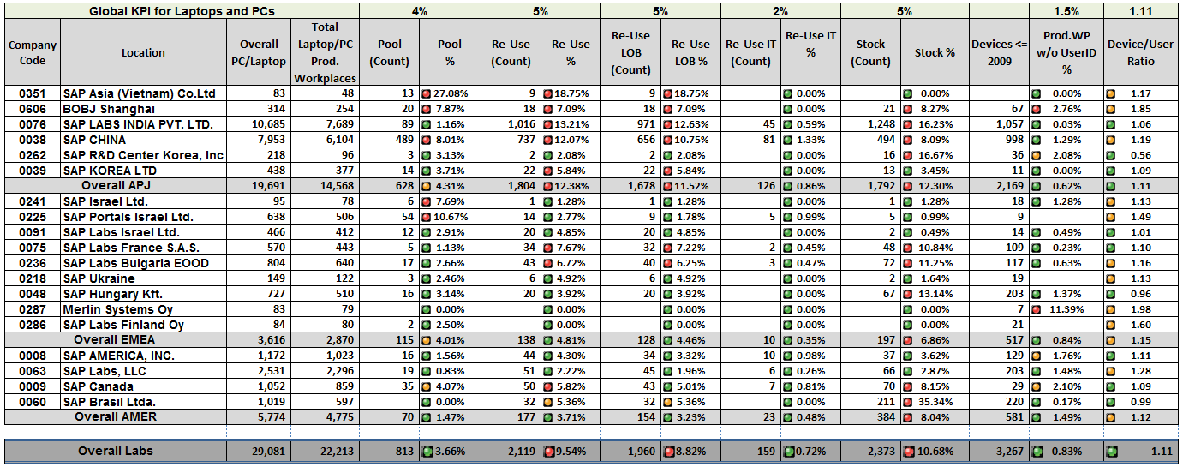
PCs & Laptops– KPI Status in Labs Locations
AMER’S Device/user Ratio includes all locations

Slide 6
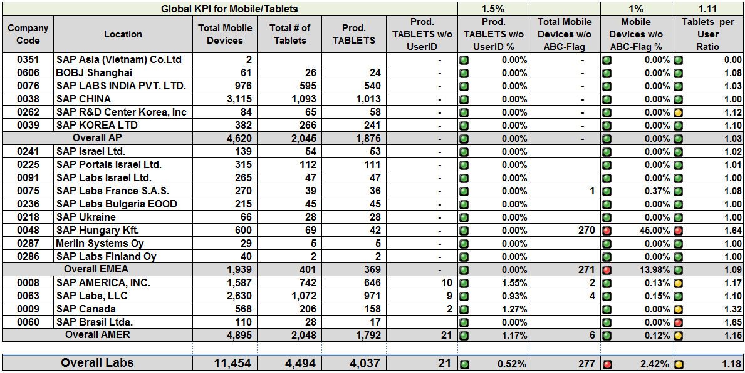
Tablet and Mobile Devices– KPI Status in Labs Locations
AMER’S Device/user Ratio includes all locations

Slide 7
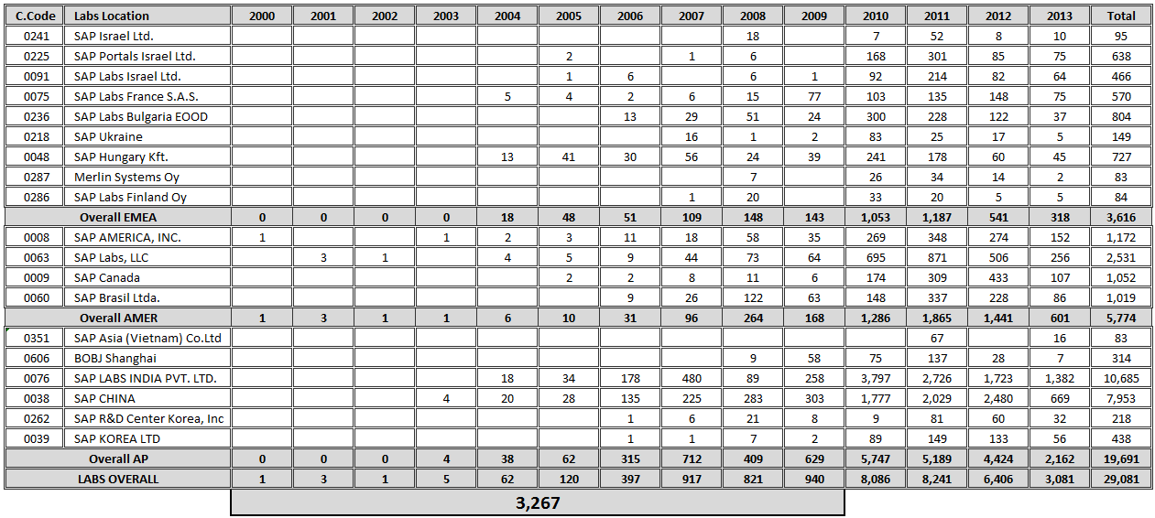
Year wise Equipment Count in Labs Locations

Slide 8
Thank You!

